Slide 1
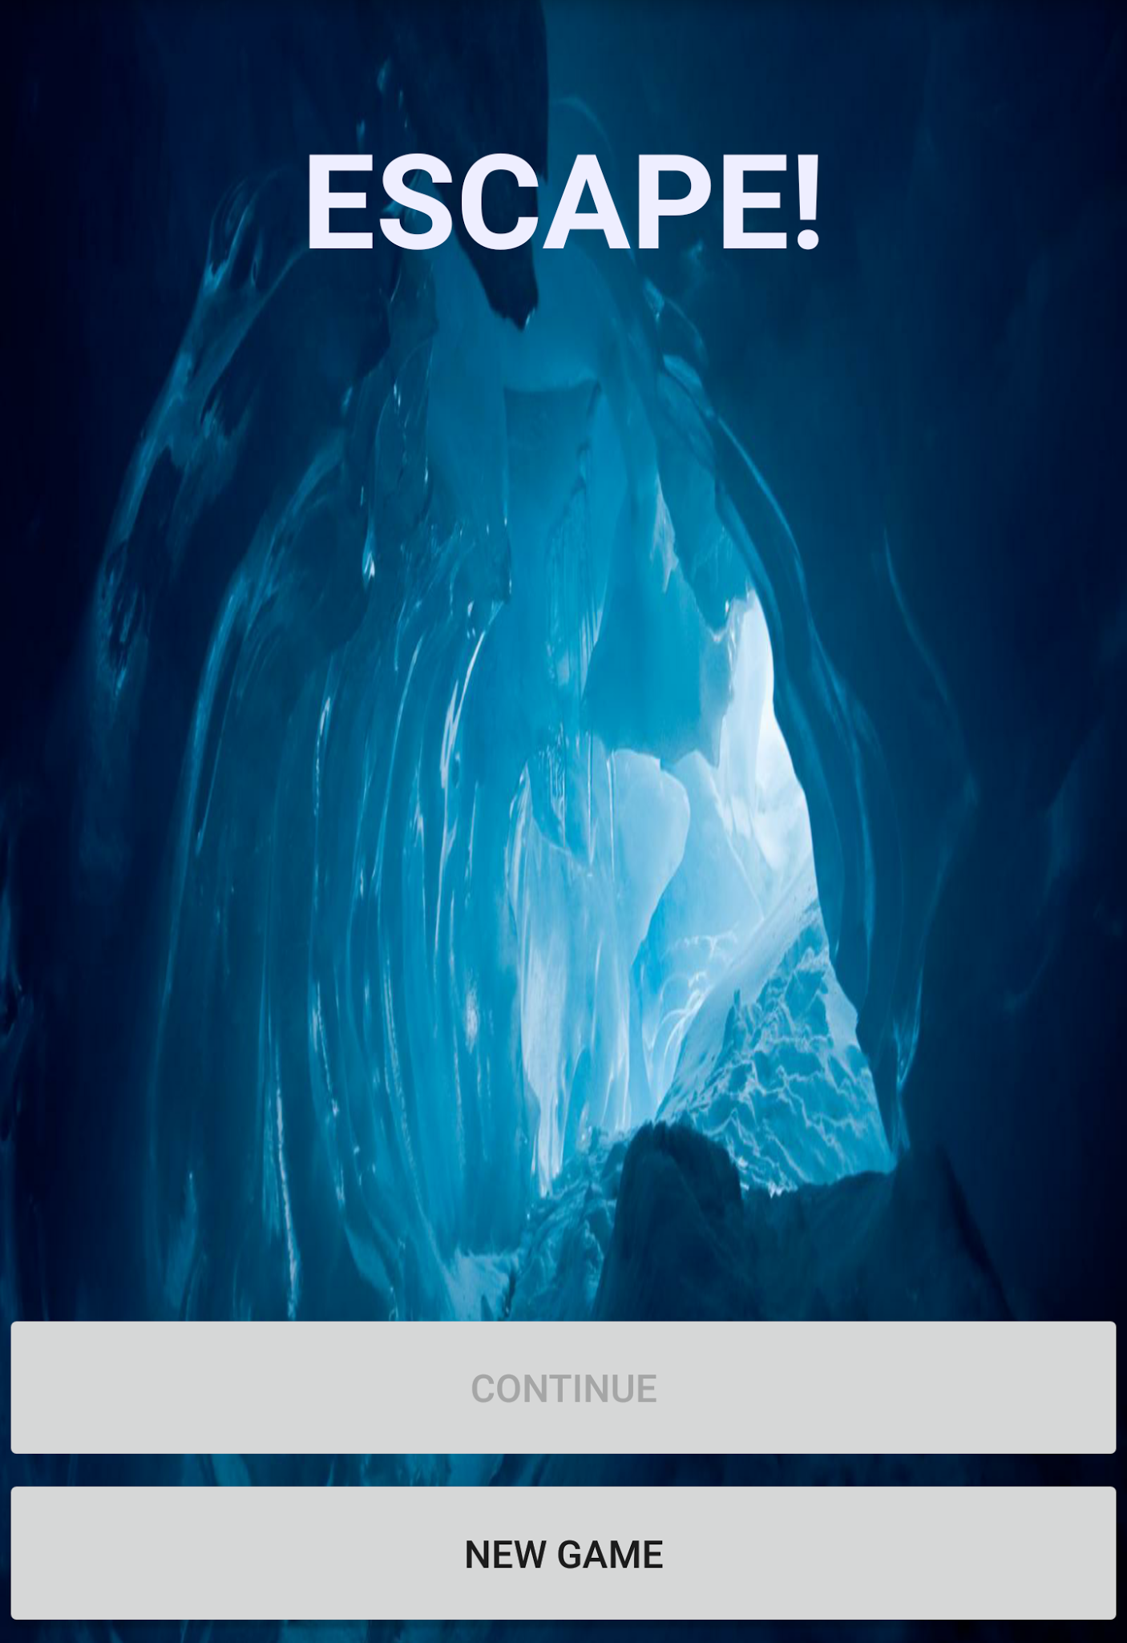
ESCAPE!
Connor Guerrieri
Adam Holt
Brent Pivnik
Joey Rener
What is it?
-Puzzle game for Android
-Player navigates grid filled with traps and obstacles to reach next level!

Slide 2
Factory Method Pattern
GameObjectFactory
Generates polymorphic GameObjects based on type of GameObject and x,y coordinates
LevelFactory
Creates Level object based on placement of GameObject instances

Slide 3
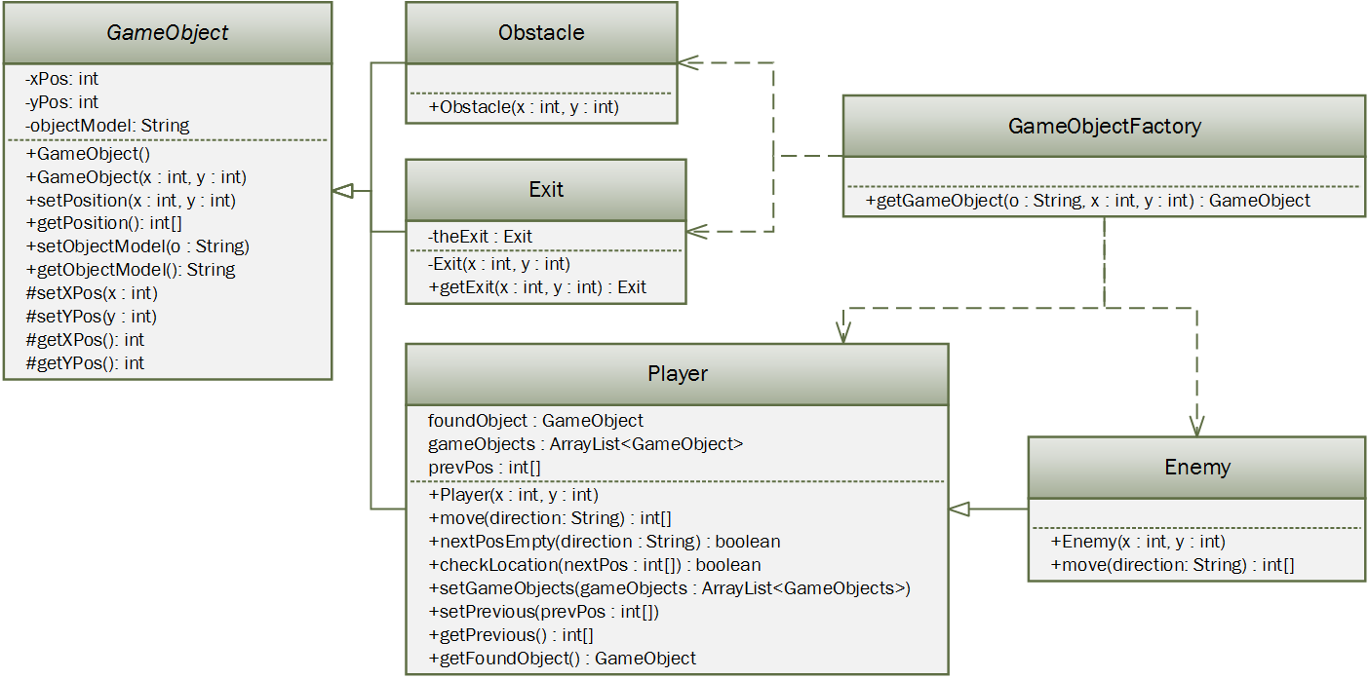
Factory Method Pattern

Slide 4
Singleton Pattern
Used when we want to restrict instantiation of a class to one instance of an object
We only wanted one Exit and one GameBoard in the game
Allows game to execute around the methods of one object instead of multiple classes all calling/instantiating back and forth

Slide 5
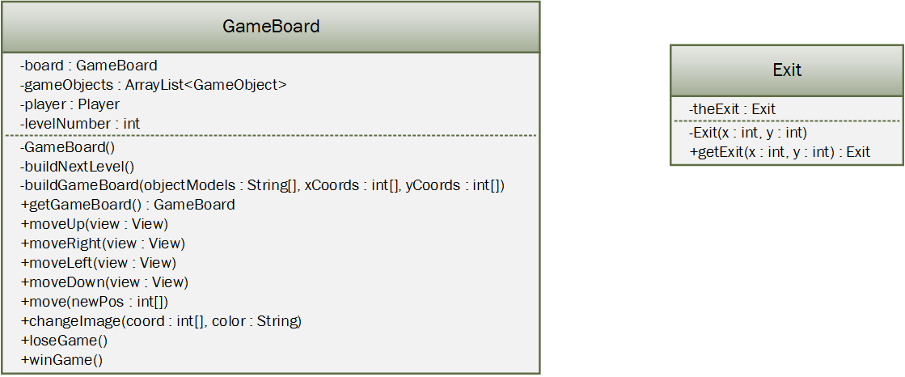
Singleton Pattern

Slide 6
What Did We Learn?
The importance of using diagrams
The importance of having a well constructed back-end
The utility of design patterns

Slide 7

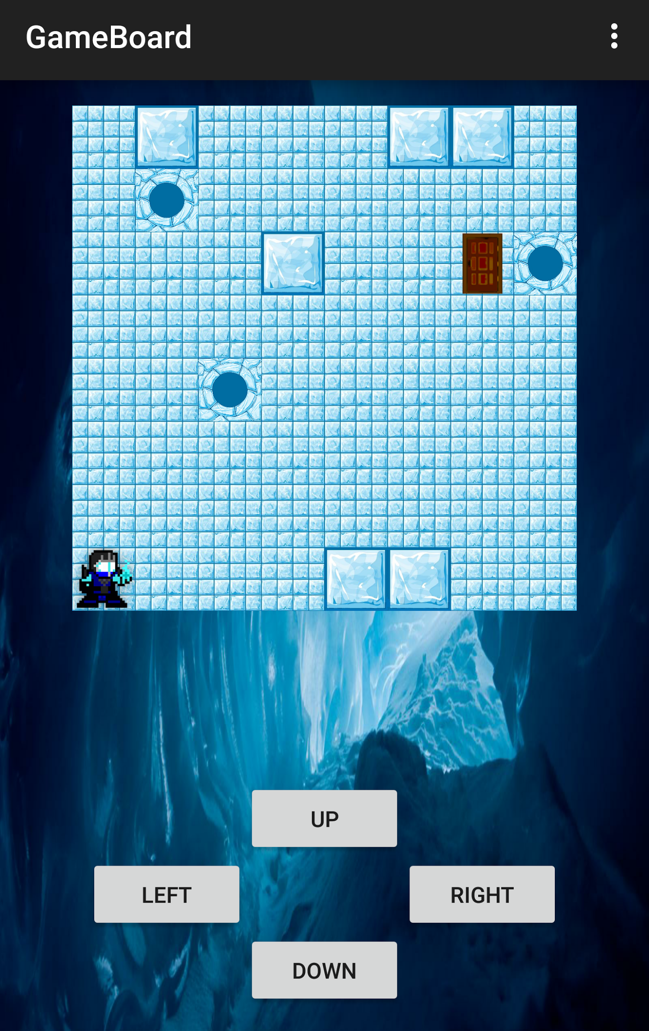
Game Demo

